Slide 1
Website and C# Application for Covid-19 Vaccination System (C-19vaccinePRO)
Group Members
KADSE201F-005 - Pubudu Deepamal
KADSE201F-016 - Suranjith Madhushan
KADSE201F-023 - Nadeesha Dilshan
KADSE201F-034 - Dineshi Wettewa

Slide 2
Introduction
The COVID-19 pandemic is an ongoing global pandemic has affected the entire population. According to research one of the best way to decrease the pandemic is vaccination. Even though Sri Lanka also started the COVID-19 vaccination but still most of the places use manual systems.
By creating this system, we are trying to facilitate the people who are willing to get vaccine, and decrease the traffic to make it more efficient. Not only people are who willing to take the vaccine, but also doctors, nurses, healthcare workers and all who help for this campaign can support it easily by using this system.

Slide 3
Aims and Objectives
We implement this system is to overcome the issues that people facing when taking the COVID-19 vaccine. What we suggest is to provide an online platform to fulfil the needs of the users and provide them a proper service by sending the exact time, place and vaccine details. Users have ability to search through the website and enter correct details of them.
This will help both the users and healthcare workers because they can keep records of the people who take the vaccine more safety without manually handling it. This system generate a receipt and people can aware of their vaccination details. By all these features we provide user friendly environment.

Slide 4
Solution
The proposed solution is to create an online vaccination system with new technology that will improve the entire manual system.
C-19vaccinePRO website mainly focuses on the following functions,
Store patient details
Add and remove patient details
Confirmation about the vaccination by using an email
C-19vaccinePRO C# application mainly focus on the following functions,
Store patient details
Add or remove patient details
Store staff details
Add or remove staff details
Confirmation about the vaccination by using an email and receipt
Display vaccination details by report

Slide 5
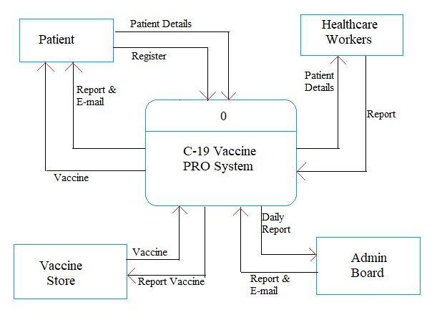
Context diagram

Slide 6
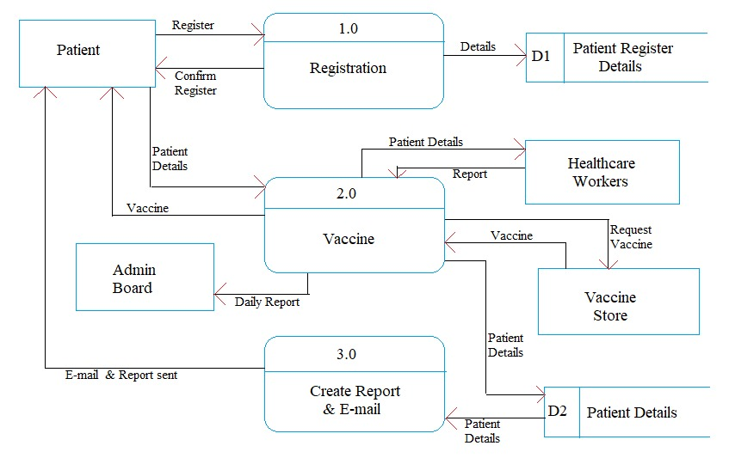
Level 0 diagram

Slide 7
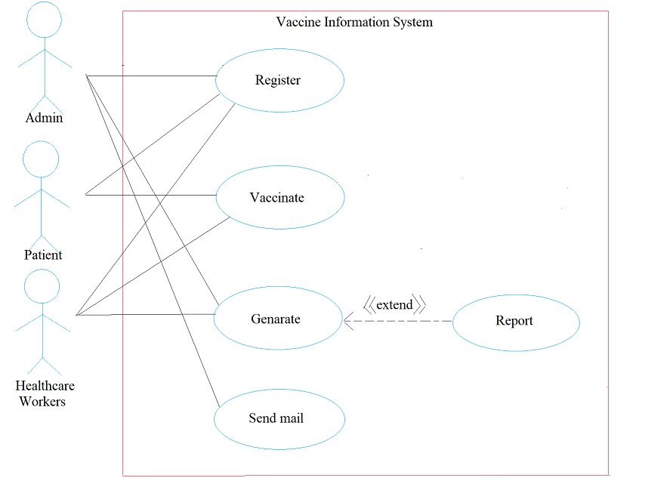
Use case diagram

Slide 8
Software
Visual Studio Code
Visual Studio
Wamp Server

Slide 9
Thank You

